Slide 1
Memory Management

Slide 2
Background
Program must be brought (from disk) into memory and placed within a process for it to be run
A programmer will like to have memory
Infinitely large
Infinitely fast
Non volatile
However, we have Memory Hierarchy:
Registers
Cache
Main Memory
Disk

Slide 3
Memory Manager
The part of the OS that manages the Memory Hierarchy
Which part of memory is in use and which is not in use
Allocate memory
De-allocate memory
Swapping between main memory and disks

Slide 4

Multistep Processing of a User Program

Slide 5
Dynamic Loading
Unused routine is never loaded
Useful when the code size is large
Unix execv can be categorized:
Overloading a necessary program onto the current program.
main( ) {
f1( );
}
f1( ) {
f2( );
}
f2( ) {
f3( );
}
1. Loaded when called
memory
2. Loaded when called
3. Loaded when called

Slide 6
Dynamic Linking
Linking postponed until execution time.
Small piece of code, stub, used to locate the appropriate memory-resident library routine.
Stub replaces itself with the address of the routine, and executes the routine.
Operating system needs to check if routine is in processes’ memory address
int x;
void main(){
stub = dlopen(“lib”):
f = dlsym(stub, “f1”);
f( );
}
memory
int x;
void main(){
stub = dlopen(“lib”):
f = dlsym(stub, “f1”);
f( );
}
lib.so.a
extern int x;
f1( ) {
x = 5;
}
extern int x;
f1( ) {
x = 5;
}

Slide 7
Binding of Instructions and Data to Memory
Binding of Instructions and Data to Memory address is called Address binding
Address binding of instructions and data to memory addresses can happen at three different stages
Compile time
Load time
Execution time:

Slide 8
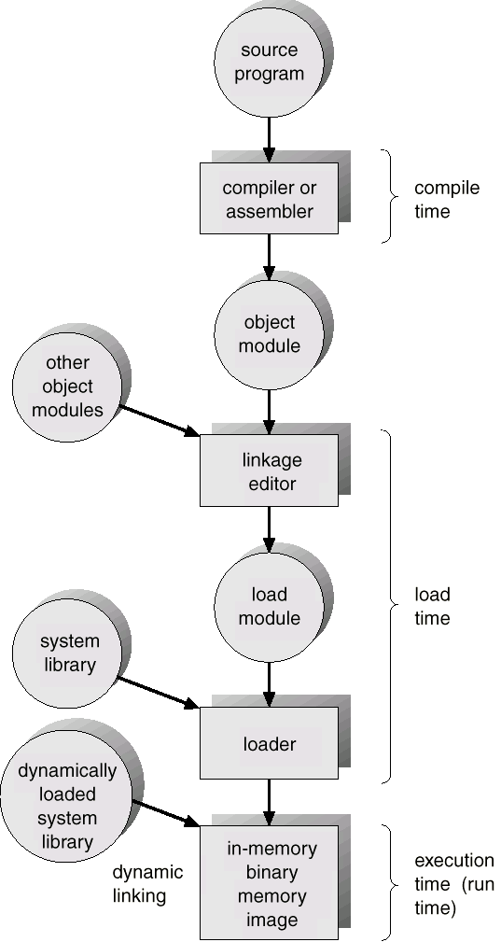
Address Binding
Compile time: Code is fixed to an absolute address. Recompilation is necessary if the starting location changes. (MS-DOS .COM format )
Load time: Code can be loaded to any portion of memory. (Relocatable code)
Run time: Code can be move to any portion of memory during its execution.

Slide 9
Logical vs. Physical Address Space
The concept of a logical address space that is bound to a separate physical address space is central to proper memory management
Logical address – generated by the CPU; also referred to as virtual address
Physical address – address seen by the memory unit
Logical and physical addresses are the same in compile-time and load-time address-binding schemes;
logical (virtual) and physical addresses differ in execution-time address-binding scheme
Logical address space is the set of all logical addresses generated by a program
Physical address space is the set of all physical addresses generated by a program

Slide 10
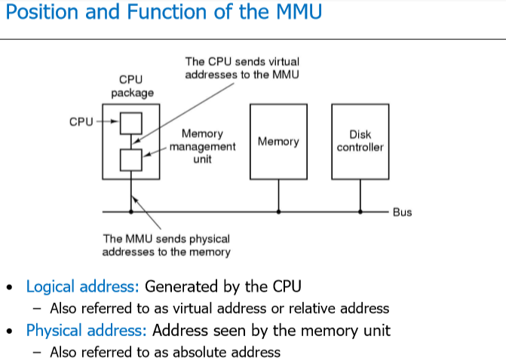

Slide 11
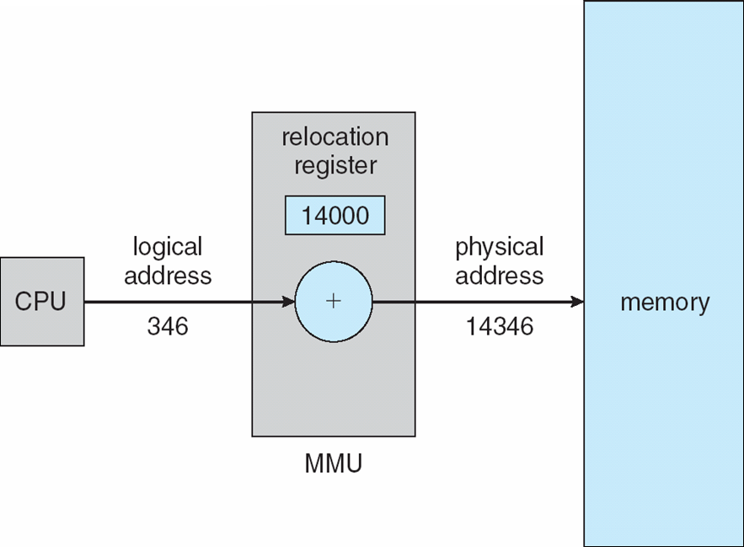
Logical vs. Physical Address Space
Physical address: The actual hardware memory address.
32-bit CPU’s physical address 0 ~ 2³²-1 (00000000 – FFFFFFFF)
1GB’s memory address 0 ~ 2³⁰-1
(00000000 – 4FFFFFFF)
Logical address: Each (relocatable) program assumes the starting location is always 0 and the memory space is much larger than actual memory

Slide 12
Memory Management Requirements
Speed is not the only issue
Relocation
Protection
Sharing
Physical memory organisation
….

Slide 13
Relocation : When a program is run it does not know in advance what location it will be loaded at.
Therefore, the program cannot simply generate static addresses (e.g. from jump instructions).
Instead, they must be made relative to where the program has been loaded.

Slide 14
Protection : Once you can have two programs in memory at the same time there is a danger that one program can write to the address space of another program.
This is obviously dangerous and should be avoided.

Slide 15
Relocation and Protection
800K
Partition 4
700K
Different jobs will run at different addresses
Suppose, the first instruction is
call a procedure at absolute address 10 within the binary file
If the process is loaded in 1st partition
Partition 3
400K
Partition 2
200K
Partition 1
Operating System
100K
0
This call will jump inside the Operating system

Slide 16
Relocation and Protection
800K
Partition 4
700K
Solution:
If the program is loaded in 1st partition, then
Call 100k + 10
If the program is loaded in 2nd partition, then
Call 200k + 10
So on…
This is called Relocation problem
Partition 3
400K
Partition 2
200K
Partition 1
Operating System
100K
0

Slide 17
Relocation and Protection
800K
Partition 4
700K
Solution:
Add an offset to each address in the program
The offset depends on the partition, e.g.,
if the Program is loaded in partition 1, add 100k to every address
if the Program is loaded in partition 2, add 200k to every address
Partition 3
400K
Partition 2
200K
Partition 1
Operating System
100K
0
A program can still generate an address that jumps in the OS or other user’s code
We need to Protect the code

Slide 18
Requirements: Protection
Processes should not be able to reference memory locations in another process without permission
Impossible to check absolute addresses at compile time
Must be checked at run time

Slide 19
Relocation and protection - Solution
A solution, which solves to equip the machine with two registers called the base and limit registers.
Base register stores the start address of the partition
Limit register holds the length of the partition.
Any address that is generated by the program has the base register added to it.
In addition, all addresses are checked to ensure they are within the range of the partition.

Slide 20

Contiguous Memory Allocation
MMU
(Memory Management Unit)
For each process
Logical space is mapped to a contiguous portion of physical space
A relocation and a limit register are prepared
Relocation register = the starting location
Limit register = the size of logical address space

Slide 21
Relocation and Protection
Addition and comparison has to be performed on every address
Use a hardware module
Interrupt
800K
Partition 4
Absolute Address
Physical Address
700K
Limit Register
Comparator
Partition 3
400K
Partition 2
Base Register
Adder
200K
Partition 1
Memory Management Unit (MMU)
Operating System
100K
Relative Address
Logical Address
0

Slide 22
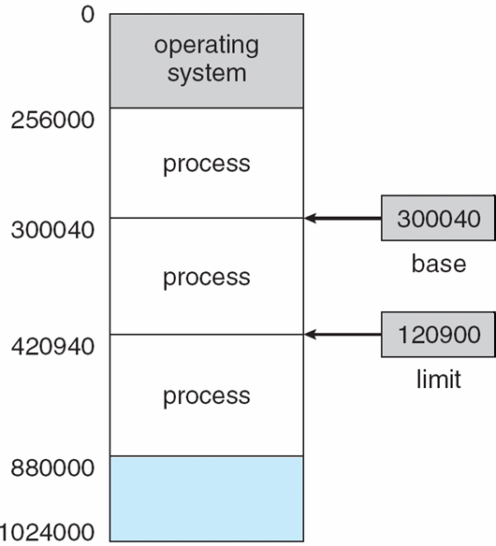
Relocation and Protection
Solution:
Base and Limit Registers
When a process is scheduled
Base Register is loaded with the starting address of the Partition
Limit Register is loaded with the length of the Partition
Before referring to memory
Add the base register contents to generated memory address
Also check against the Limit register for protection

Slide 23
Uni-programming
Run just one program at a time
Memory is shared between
A User program
Operating system
User Program
Operating System
The user types a command on the prompt
The OS
Copies the program from the disk to memory
Executes the program
After execution, prompt is available again
The new program is copied into RAM, overwriting the previous one

Slide 24
Multi-programming systems
Keep more than one process in memory
Benefits?
How to organize memory to achieve this?
One basic approach is to divide memory into n (usually unequal partitions)

Slide 25
Multi-programming systems
Keep more than one process in memory
Benefits?
How to organize memory to achieve this?
One basic approach is to divide memory into n (usually unequal partitions)

Slide 26
Memory Management
We start with the case where a process image is projected in simple fashion on physical memory
normally, this implies that the process image is smaller than physical memory and the program is fully loaded for execution.
We will look at the following simple memory management techniques :
fixed partitioning
dynamic partitioning
paging

Slide 27
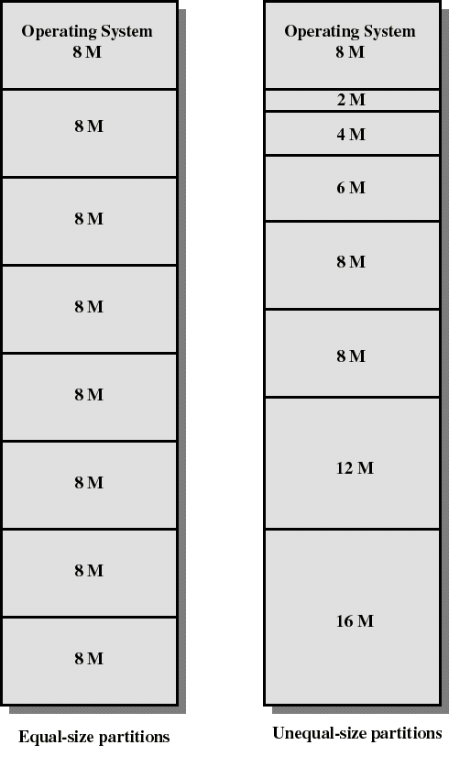
Fixed Partitioning
Partition main memory into a set of non overlapping regions called partitions
Partitions can be of equal or unequal sizes
..both pictures show partitioning of 64 M main memory

Slide 28
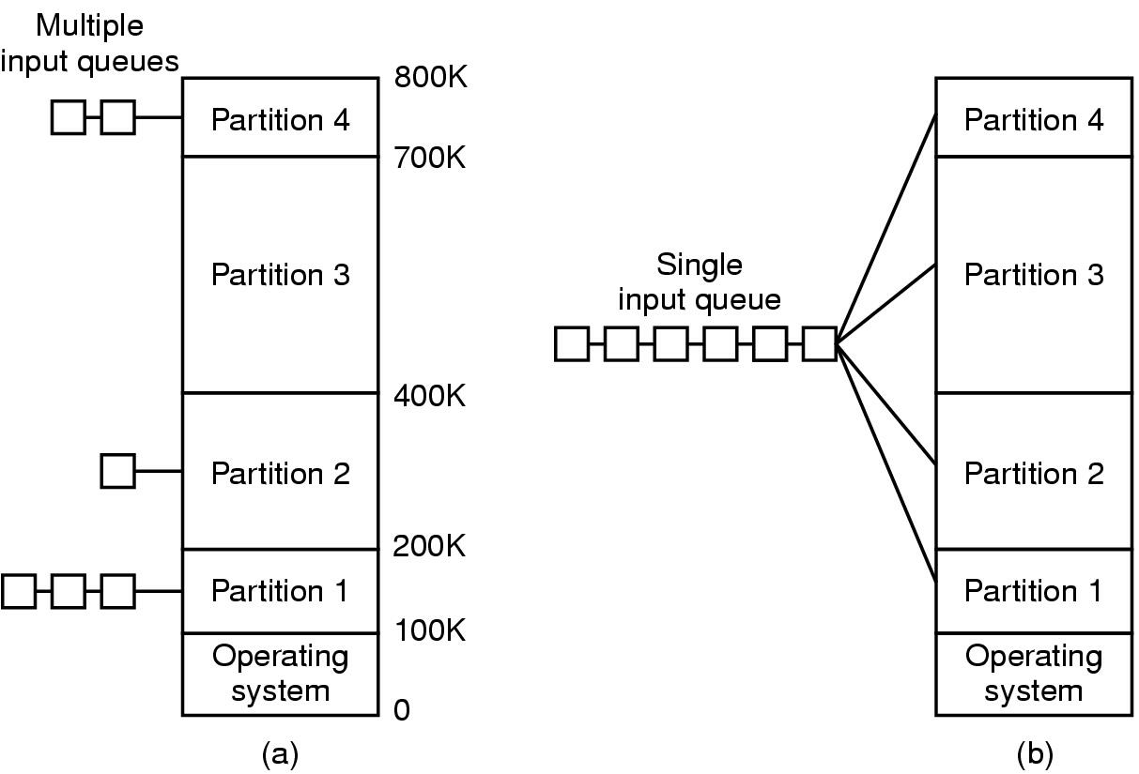
Multiprogramming with Fixed Partitions
If the job size < Partition size, memory is wasted
When a job arrives
its put into the input queue of
The smallest partition large enough to hold the job

Slide 29
Multiprogramming with Fixed Partitions
Disadvantage of Multiple Queues:
When a large partition is empty
And queues for small partition is full
Small jobs have to wait, even though plenty of memory is free
Alternative: Maintain a single Queue

Slide 30
Multiprogramming with Fixed Partitions
Whenever a partition becomes free, a job is selected
Closest to the front of the queue
Smaller than the partition size
Undesirable to waste a large partition for smaller job
Search the queue, find the largest job that fits is
Unfair for smaller jobs
A job may not be skipped more than k times
800K
Partition 4
700K
Partition 3
400K
Partition 2
200K
Partition 1
Operating System
100K
0

Slide 31
Overlays in Memory Management
A program may be too large to fit in a partition. The programmer would then use overlays:
whenever a process is running it will not use the complete program at the same time, it will use only some part of it.
whatever part is required,
it is loaded it an once and executed
It is unloaded
means just pull it back and get the new part you required and run it

Slide 32
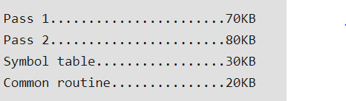
Overlays Example
Let assume that available main memory size is 150As the total code size is 200KB and main memory size is 150KB,
it is not possible to use 2 passes together.
So, in this case, we should go with the overlays technique.
According to the overlays concept at any time only one pass will be used and both the passes always need symbol table and common routine.KB and total code size is 200KB

Slide 33
Fixed Partitioning - Problem
Main memory use is inefficient. Any program, no matter how small, occupies an entire partition.
This leaves holes of unused memory inside the partitions: internal fragmentation.
Unequal-size partitions can help
put small programs in small partitions
but there will still be holes...

Slide 34
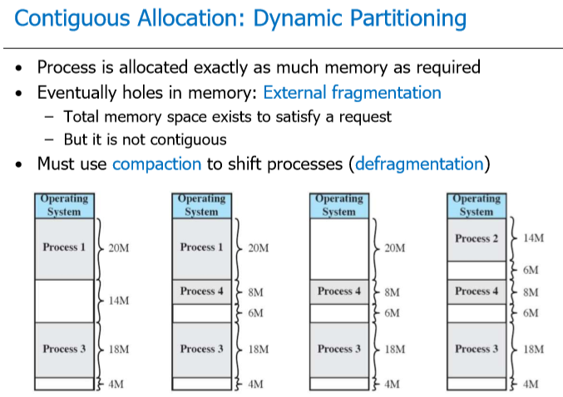

Slide 35
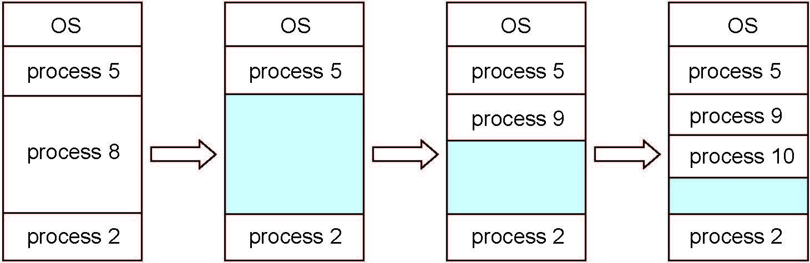
Dynamic-partition allocation
Multiple-partition allocation
Degree of multiprogramming limited by number of partitions
Variable-partition sizes for efficiency (sized to a given process’ needs)
Hole – block of available memory; holes of various size are scattered throughout memory
When a process arrives, it is allocated memory from a hole large enough to accommodate it
Process exiting frees its partition, adjacent free partitions combined
Operating system maintains information about: a) allocated partitions b) free partitions (hole)

Slide 36
Dynamic Storage-Allocation Problem
How to satisfy a request of size n from a list of free holes?
First-fit: Allocate the first hole that is big enough
Best-fit: Allocate the smallest hole that is big enough; must search entire list, unless ordered by size
Produces the smallest leftover hole
Worst-fit: Allocate the largest hole; must also search entire list
Produces the largest leftover hole
First-fit and best-fit better than worst-fit in terms of speed and storage utilization

Slide 37
Fragmentation
External Fragmentation – total memory space exists to satisfy a request, but it is not contiguous
Internal Fragmentation – allocated memory may be slightly larger than requested memory; this size difference is memory internal to a partition, but not being used

Slide 38
Internal Fragmentation
Memory that is internal to a partition but not being used
800K
Partition 4
B
Internal Fragmentation
700K
A
Partition 3
Internal Fragmentation
400K
Partition 2
200K
Partition 1
Operating System
100K
0

Slide 39
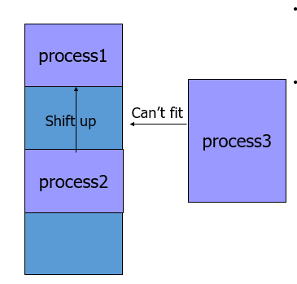
External Fragmentation

Slide 40
Swapping
If not enough space in memory for all the currently active processes
Excess processes must be kept on disk
Fully ➔ Swapping
Partially ➔ Virtual Memory
Example of Swapping
Round Robin Scheduling
When the quantum expires
Swap out the currently running process
Swap in another process to freed memory space

Slide 41
Swapping
Another Example:
Priority based scheduling
If a higher priority process arrives
Swap out a lower priority process
Swap in the higher priority process
When the higher priority process exits
Swap in the lower priority process

Slide 42
Swapping
C
The number, size and location of the partition is decided dynamically.
D
B
B
A
C
A
A
D
Operating System
D is of Higher Priority, A is of Lower Priority!!!
B exits now, Swap in A

Slide 43
Swapping
Its possible to combine all the holes into one big hole
This is called COMPACTION
E
EXTERNAL FRAGMENTATION
Memory External to all partitions is Fragmented
Enough total memory exists to satisfy the request
But is not Contiguous
C
A
E
Swapping has created Holes
D
Operating System
D exits now
No Space for E !!!
Now E has enough space

Slide 44
Compaction
Compaction involves CPU overhead
If addresses are not generated relative to the partition location:
Then Compaction is not possible
How much memory should be allocated for a process?
If all the memory is allocated statically in a program
Then, OS knows exactly the amount of memory to be allocated: executable code + variables
However, if memory is allocated dynamically (say using new)

Slide 45
Memory allocation for Processes
Problem may occur whenever a process tries to grow
If a hole is adjacent to the growing process then it can be allowed to grow
If another process is adjacent to the growing process, then
The growing process should be moved to a larger hole
If a larger hole is not available, then, one or more processes should be swapped out
If a process cannot be swapped out (say, there is not enough space on disk
The growing process has to wait
Or should be killed!!!

Slide 46
Memory allocation for Processes
If most of the processes grow as they run,
It is better to allocate a little extra memory for a process
B
Room for growth
Actual in use
A
Room for growth
Actual in use
Operating System

Slide 47
Memory allocation for Processes
If processes have two growing segments
Data
(as heap for dynamically allocated variables)
Stack
B-Stack
B-Data
B-Program
Room for growth
The memory can be used by either of the two segments
If it runs out the process either
Has to be moved to a larger hole
Or swapped out
Or Killed
A-Stack
A-Data
A-Program
Room for growth
Operating System

